Slide 1

HOW TO USE THIS SLIDE DECK
THANK YOU
Remarks:
The slides start from slide 4 and continue till the end.
For the opening slide, you can choose one of the 3 options (slides 5-10) depending on your needs or preference.
You can use either a solid blue (e.g., slide 14) or white background (e.g., slide 18); both options are available.
Different formats (slides 12, 13, 16, 17) are available; you can choose whichever fits you better.

Slide 2


EUROPEAN
MCT SUMMIT 2026
21 - 23 Apr
Become your own TSP
Michael Sucháček
Independent Microsoft Cloud Consultant and Trainer

Slide 3


















SPONSORED BY
Media
Platinum
Gold
Silver
Speaker dinner & Coffee breaks
Partnering with

Slide 4

ABOUT ME
Independent Contractor
Microsoft Cloud Consultant and Trainer
Microsoft Certified Trainer Community Lead
Microsoft Most Valuable Professional

Slide 5
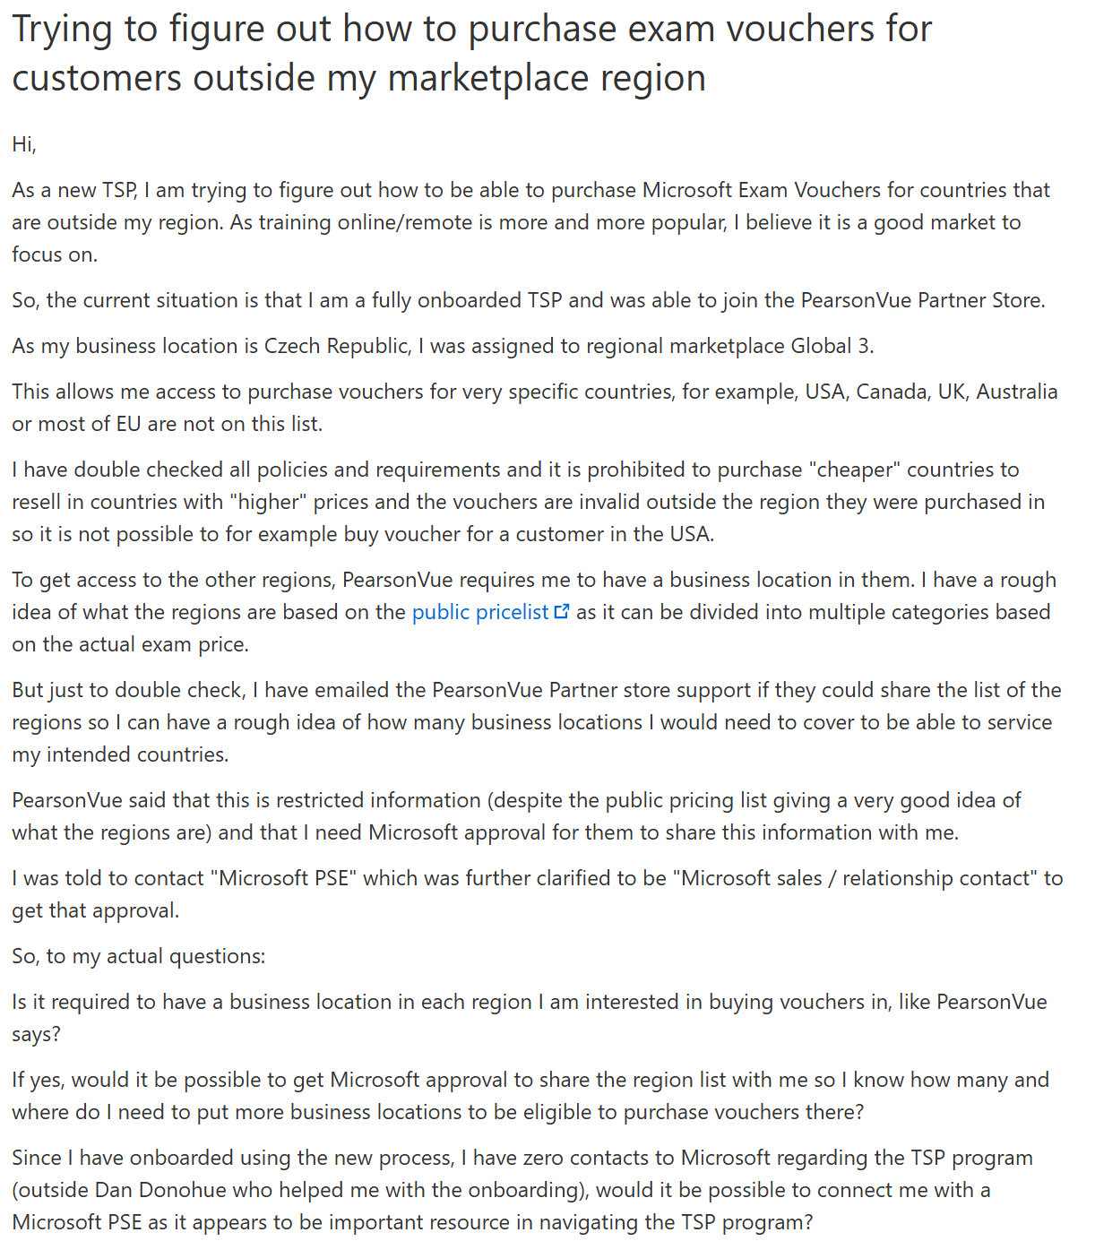
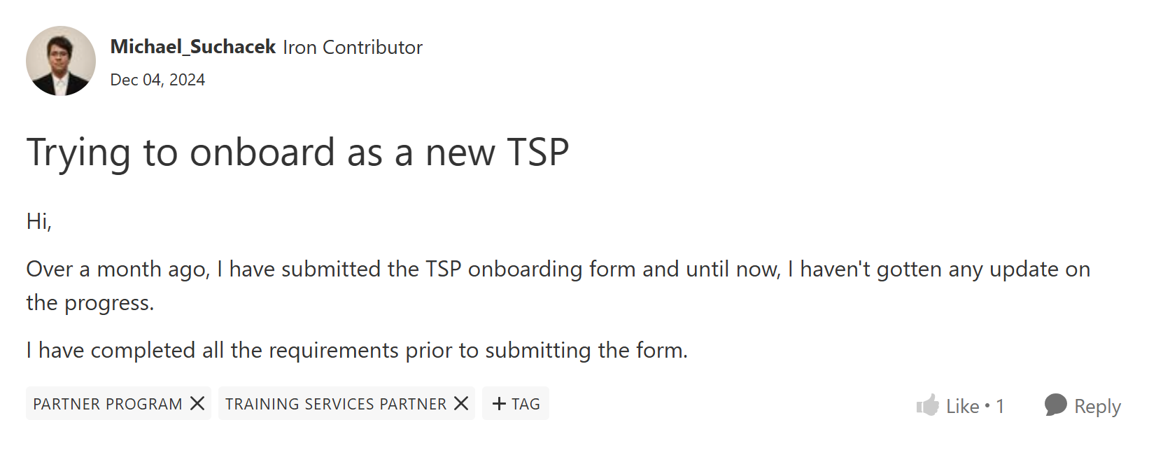
How did we get here

Slide 6
Agenda
What is the TSP program and what you need to know
How to become a Microsoft AI Cloud Partner Program (MAICPP) member
How to become a TSP
How to meet all the TSP requirements and access the benefits

Slide 7
Microsoft Training Services Partner Program
Ability to organize your own Microsoft Official Courses
Access to official ALH labs
Discounted Exam Vouchers and MeasureUp Practice Tests (15% under normal price)
Access to Partner Benefit Packages (which can TSPs use for their deliveries)
Not exclusive to the TSP program but access to CDX and free demo M365 tenants
And more!

Slide 8
Different TSP levels
„Normal TSP“
TSP with Solution Designation (per year)
Free
No hard requirements to renew
On request a letter confirming you are an authorized TSP
If inactive, might be removed from the program and have to reapply
Roughly €4,2k (+tax)
1000+ course deliveries
200+ exam voucher purchases
≥4.25 average MTM score
200 MTM surveys responses
All of this is per specific product area

Slide 9


Benefits of Solution Designation
Cool badge you can put on your website
Access to the Solution Benefit packages with extremely discounted software
Placement/Promotion in the AI Skills Navigator TSP directory
Potential access to other Microsoft Partner programs and engagements

Slide 10
Managed vs Unmanaged TSPs
Managed
Unmanaged
Only reserved for „strategic“ TSPs
Requires volume and knowing someone inside of Microsoft
Even better access to business inside Microsoft
Unreachable for most TSPs
Everyone else
Program is self-serve, you do everything yourself
No special treatment

Slide 11
Step 1: Legal Entity
To become a partner, you need to have a legal entity that Microsoft can lookup and verify it is real
In most countries easiest is LLC (Limited Liability Company) or their equivalent
I am not a lawyer, always check the business law in your country to see which option fits you the best
In some countries you can just become a „company“ yourself

Slide 12
Step 2: Microsoft Entra ID Tenant
You need to have an Entra ID tenant before even starting the process
Entra ID tenant is free, licenses aren‘t
In speaker notes there is a URL where you can create your tenant
Notes:
https://signup.microsoft.com/createaccount?culture=en-us&scenario=PartnerCenter&origin=pc

Slide 13
Step 3: Domain
You need to purchase a domain
Details on purchase invoice need to match your company information completely
Needs to be hosted somewhere, during the partner verification process, Microsoft will send you an email

Slide 14
Step 4: Start the MAICPP Sign-Up
To be able to join the Training Services Partner Program, you first need to join the Microsoft AI Cloud Partner Program (MICPP)
Microsoft will verify a couple of things to make sure you are a legitimate business and you are the person who is representing them
Notes:
https://partner.microsoft.com/en-us/dashboard/account/v3/enrollment/introduction/partnership

Slide 15
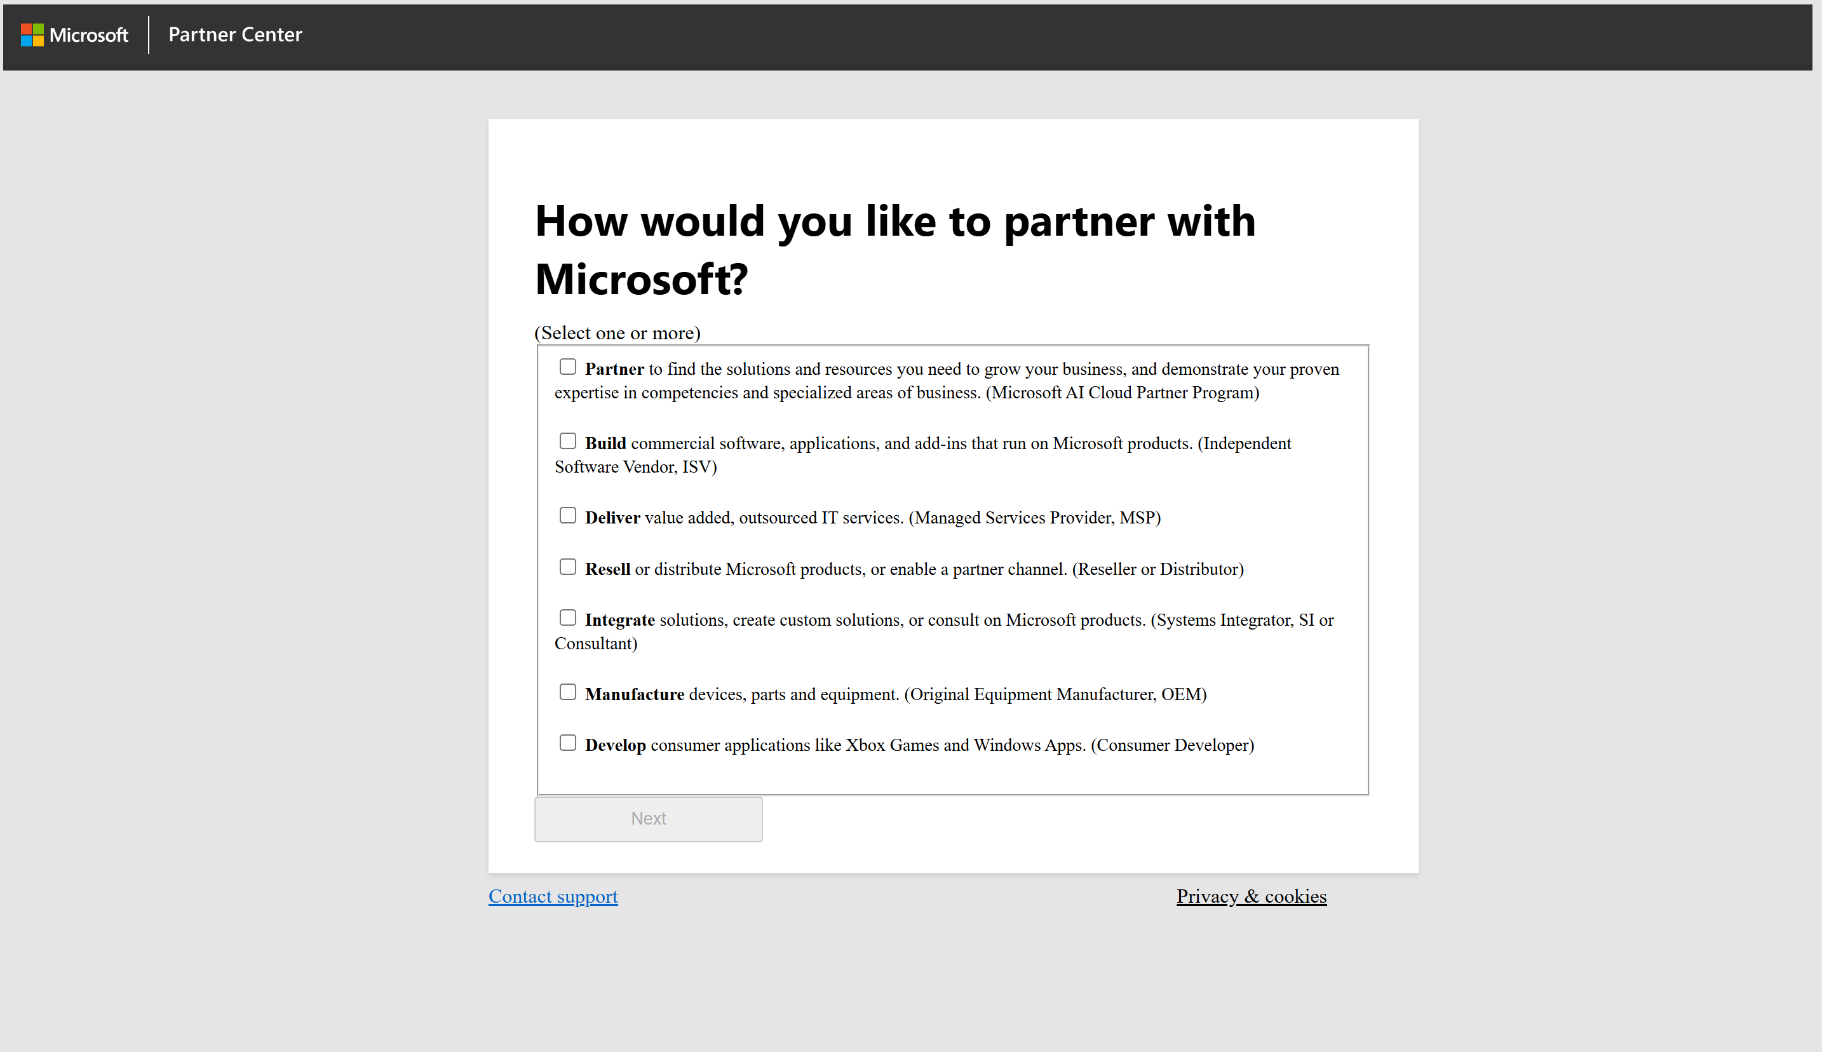

Slide 16
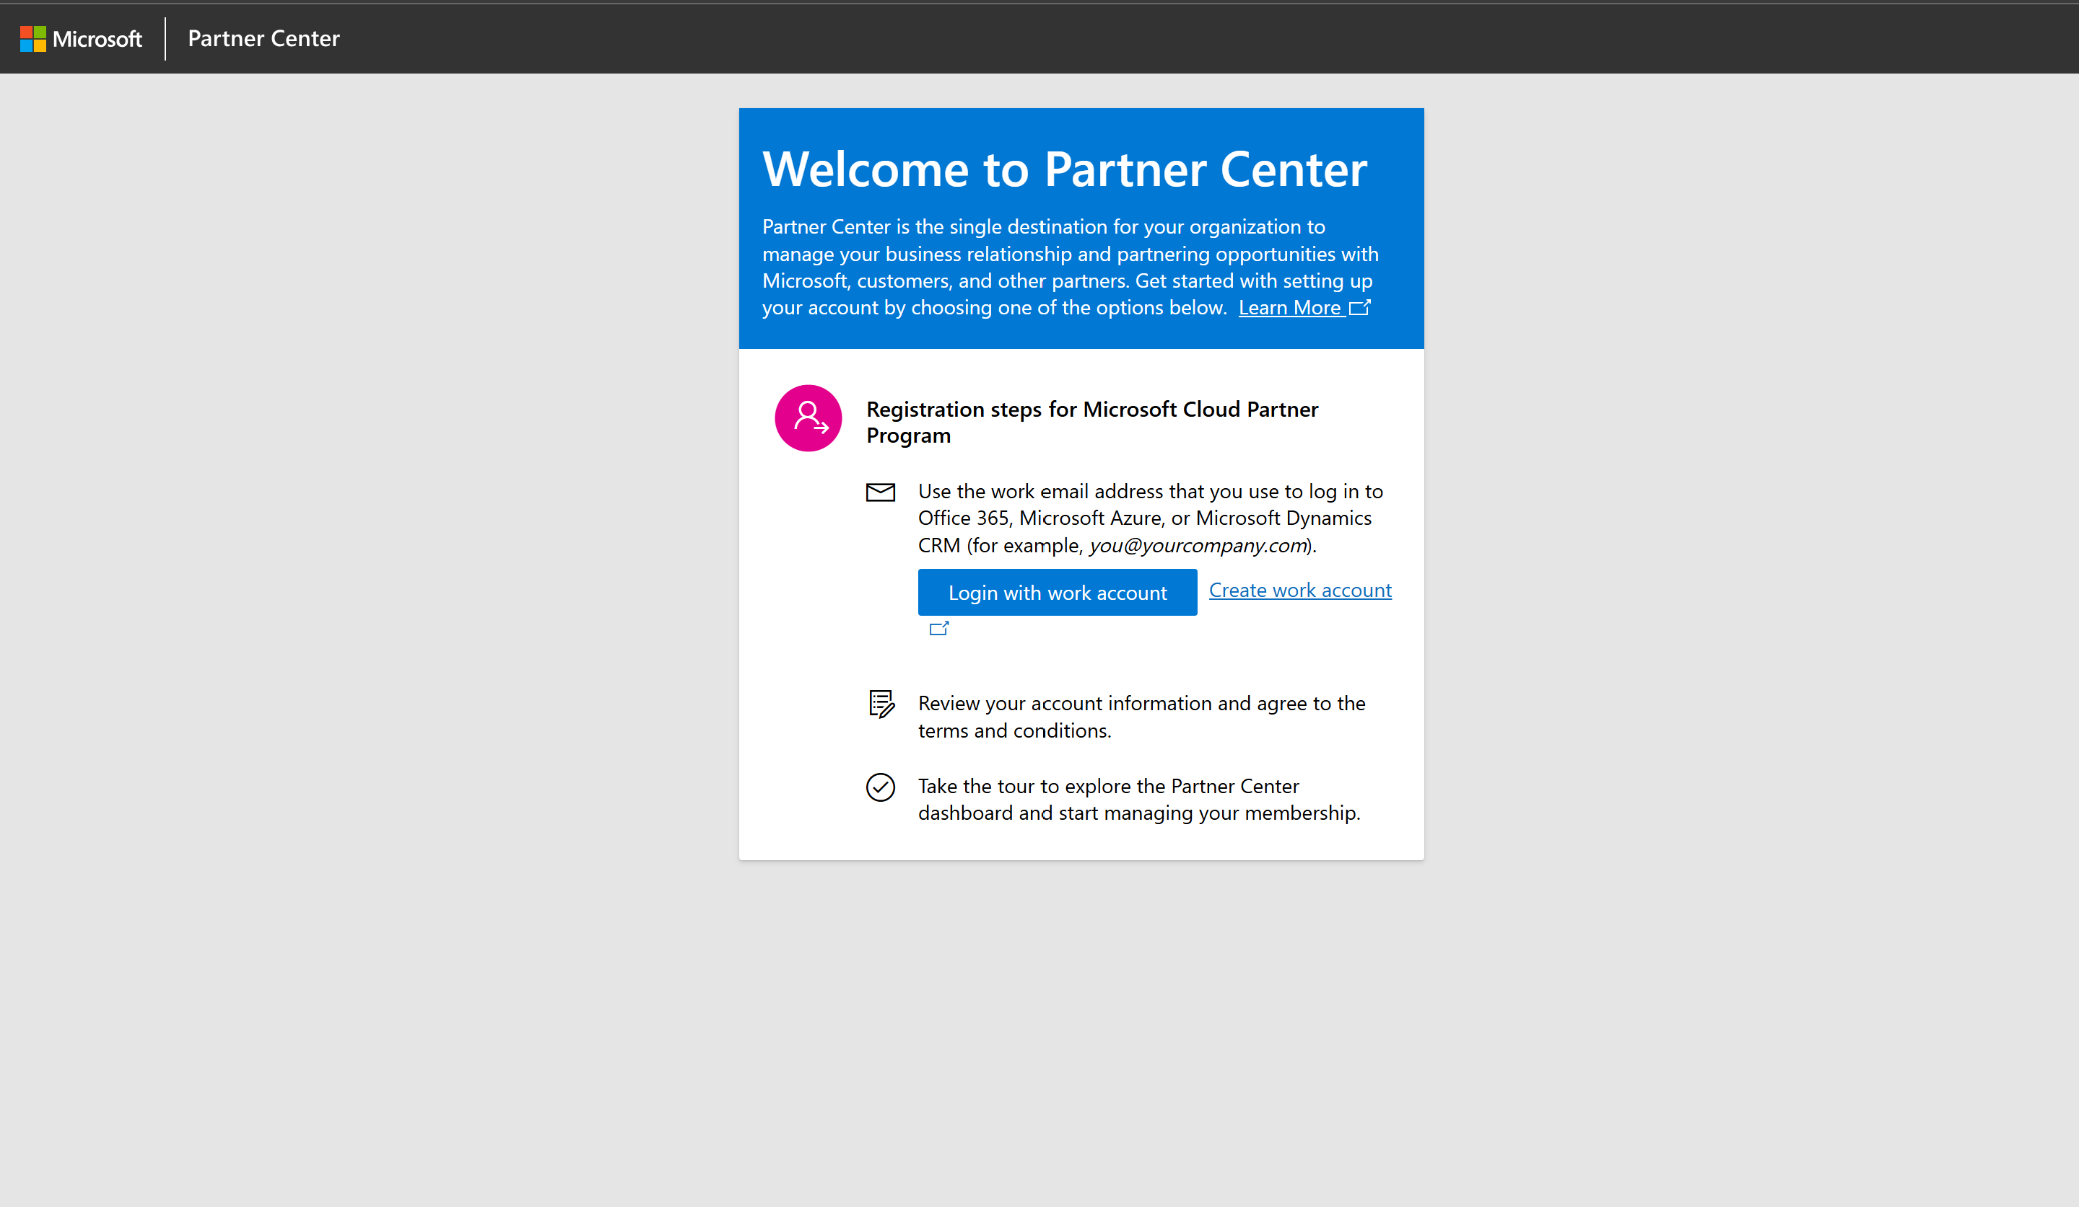

Slide 17
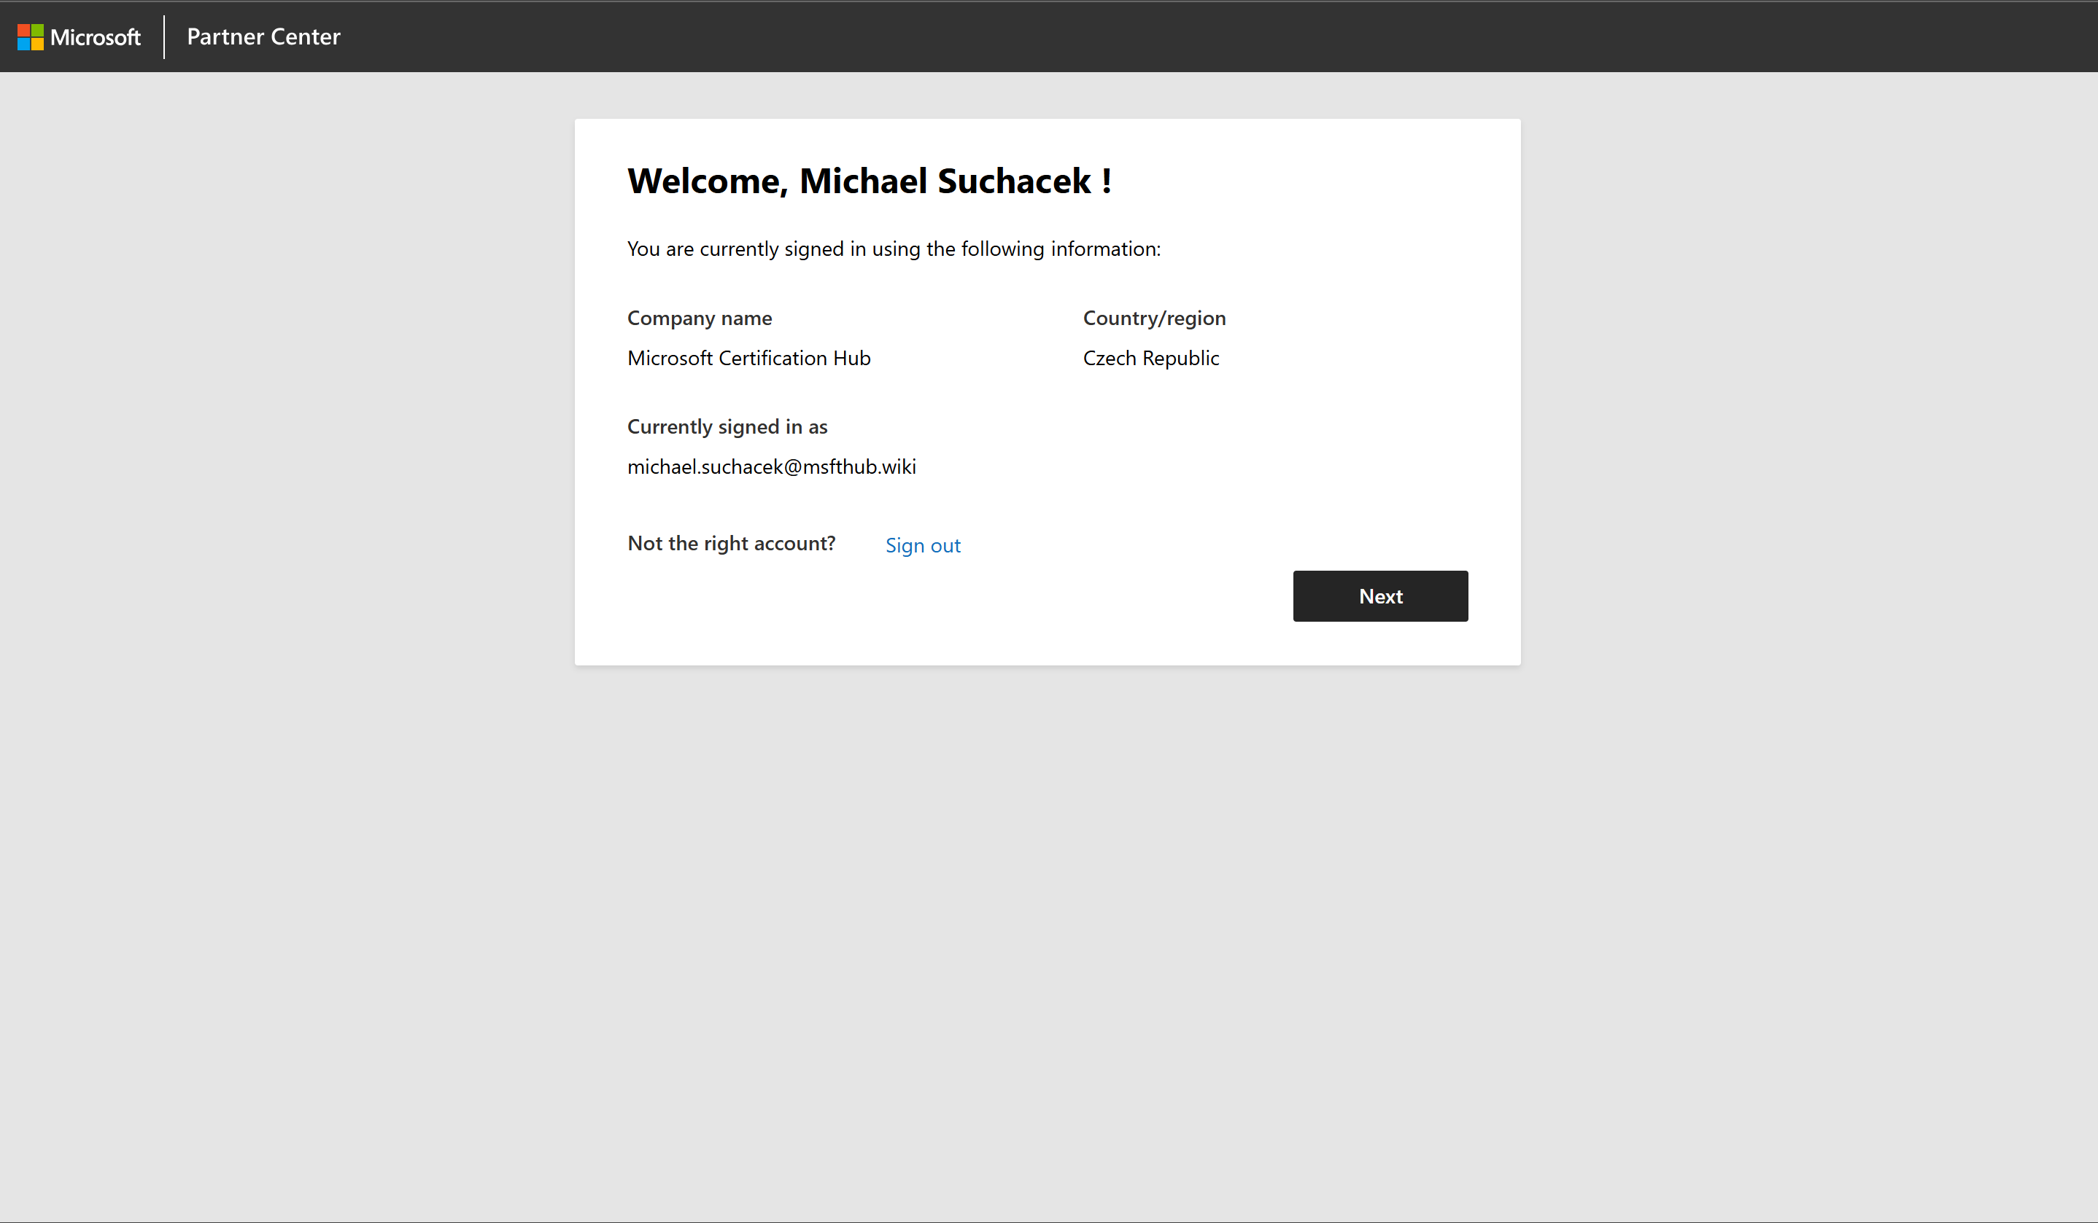

Slide 18
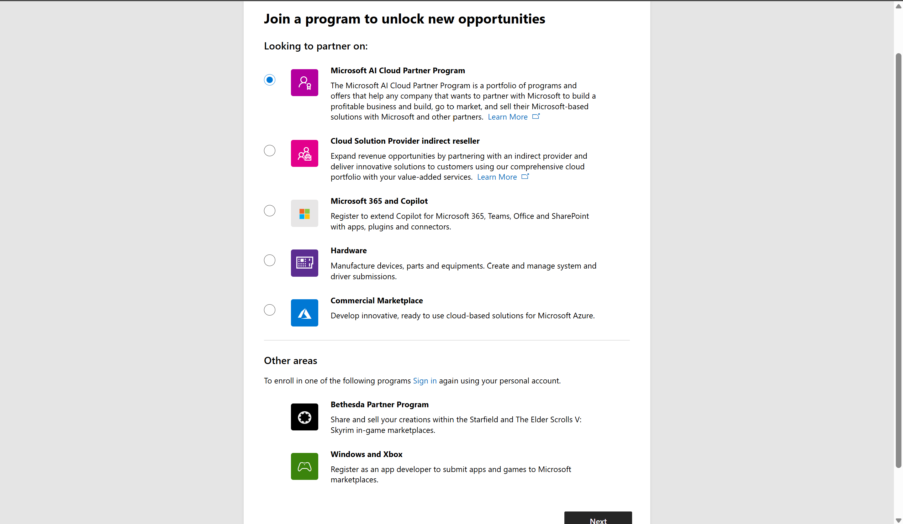

Slide 19
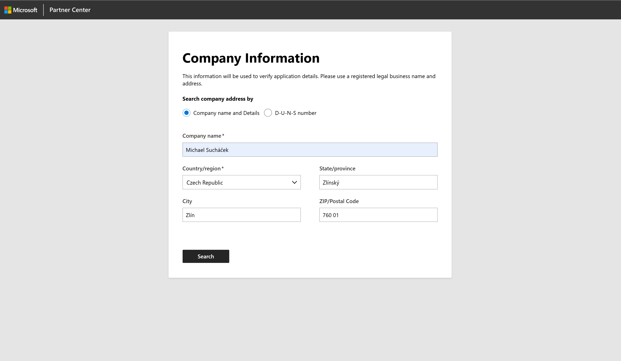

Slide 20
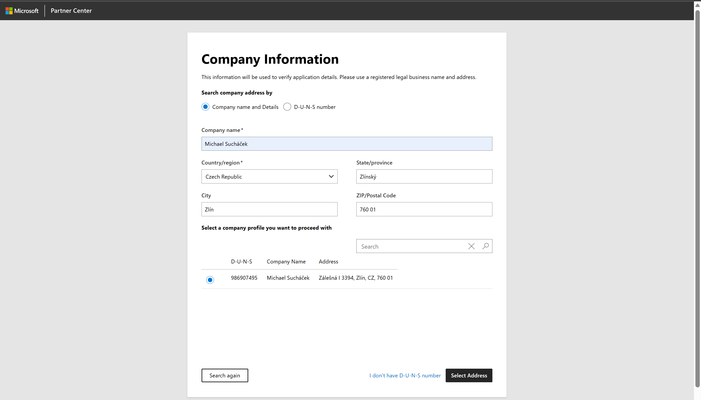

Slide 21
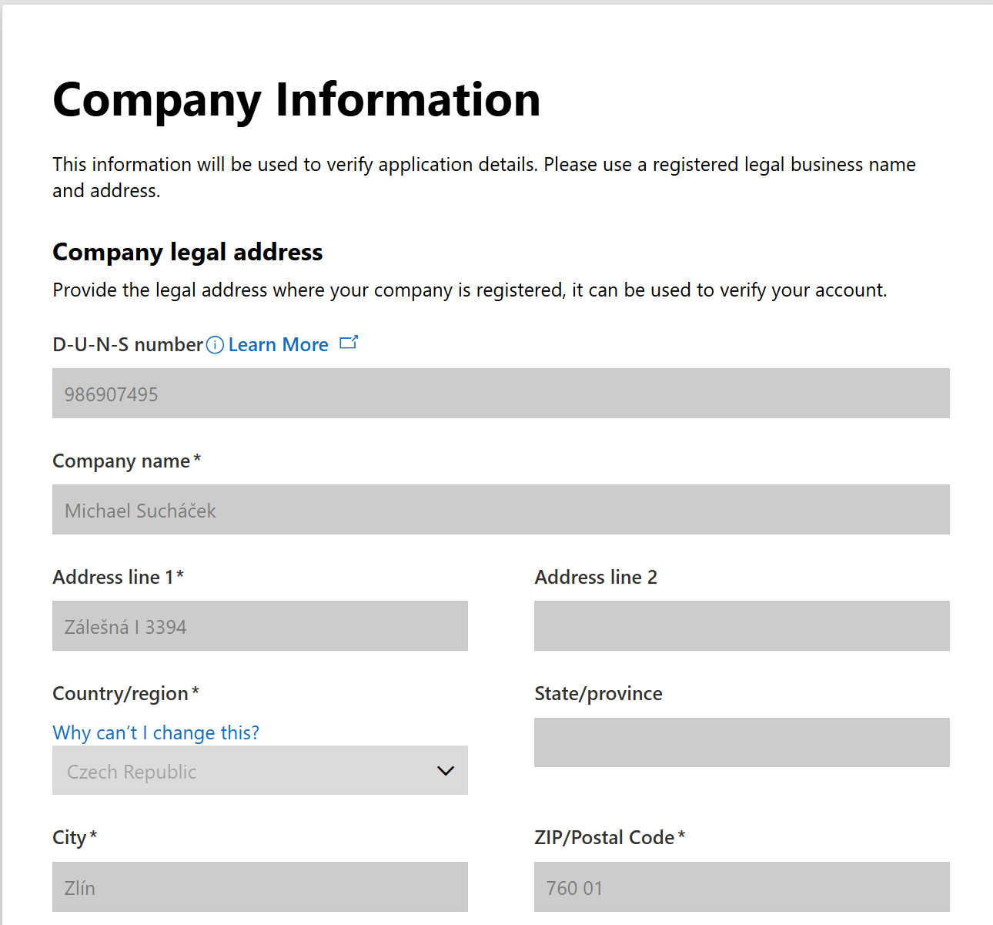
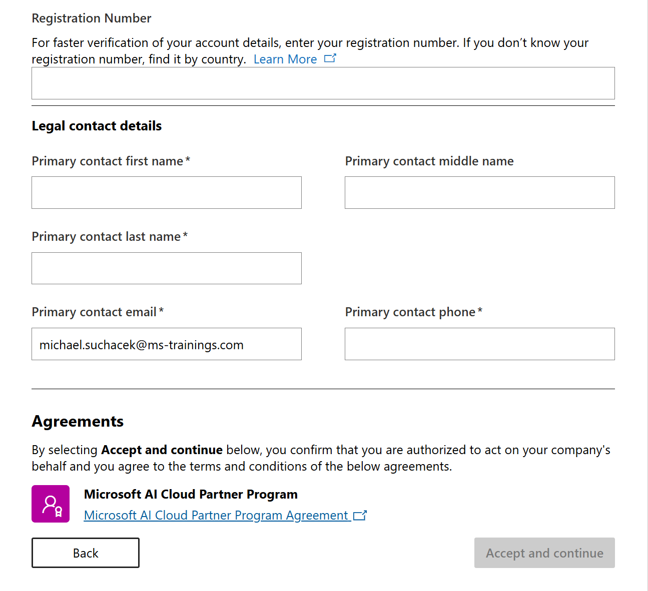

Slide 22
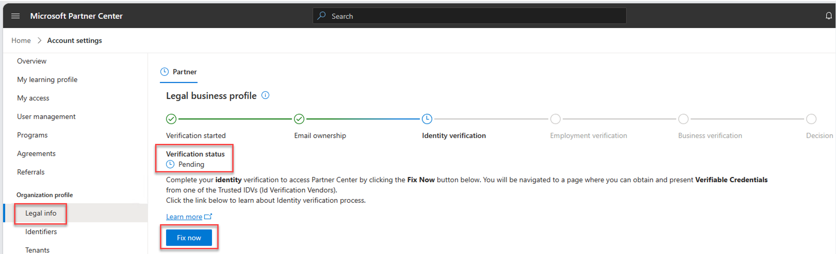

Slide 23
Email Ownership
Microsoft Sends you a verification email
You need to verify by clicking the button
You can resend the email if it didn‘t arrive
Notes:
https://learn.microsoft.com/en-us/partner-center/enroll/verification-responses

Slide 24
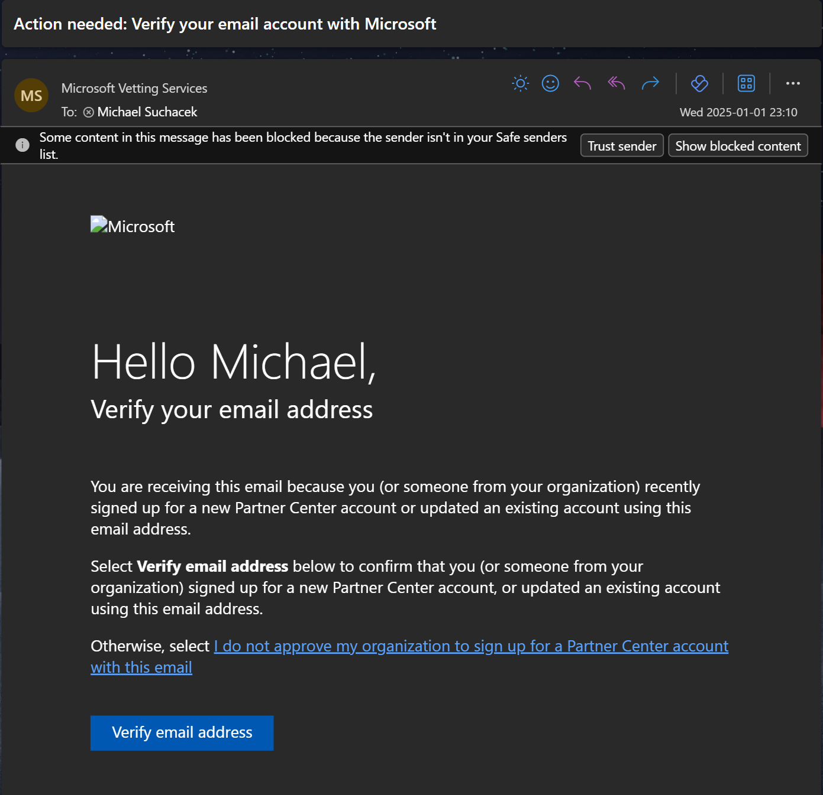

Slide 25
Identity Verification
You need to go through the Microsoft Verifiable Credentials Program
Need to provide ID and a selfie to Microsoft Vendor that facilitates the requests in your region
It will be stored in Microsoft Authenticator, don‘t delete the app or the Credential
You have 30 days, if the Partner Portal says rejected, then you will need to start over again
Notes:
https://learn.microsoft.com/en-us/partner-center/enroll/verification-responses
https://learn.microsoft.com/en-us/partner-center/enroll/get-verifiable-credentials

Slide 26
Employment Verification
You are not actually verifying your employment
You need to provide your domain purchase invoice to Microsoft that is not older than 12 months
There are other options to verify domain ownership but from my experience this one is the simplest if the invoice matches your company details
Sometimes companies bought a whole new fresh domain just for this verification step
Notes:
https://learn.microsoft.com/en-us/partner-center/enroll/verification-responses

Slide 27
Business Verification
This is where Microsoft actually checks you are a real company
If you have done everything correctly (and Microsoft was able to look you up in the directory at the beginning of the process), you should be fine
They check DUNS and country specific registries
If you are not in your country specific registry (for whatever reason), you can look into signing up for a DUNS number (not a free service)
If Microsoft is not sure, they might request additional government paperwork that you are a real company
Notes:
https://learn.microsoft.com/en-us/partner-center/enroll/verification-responses

Slide 28
Additional Due Diligence
Happens when Microsoft goes over everything and is suspicious that you are not a legitimate company
Hole that you are probably not digging yourself out of and might have to start all over again
Notes:
https://learn.microsoft.com/en-us/partner-center/enroll/verification-responses

Slide 29
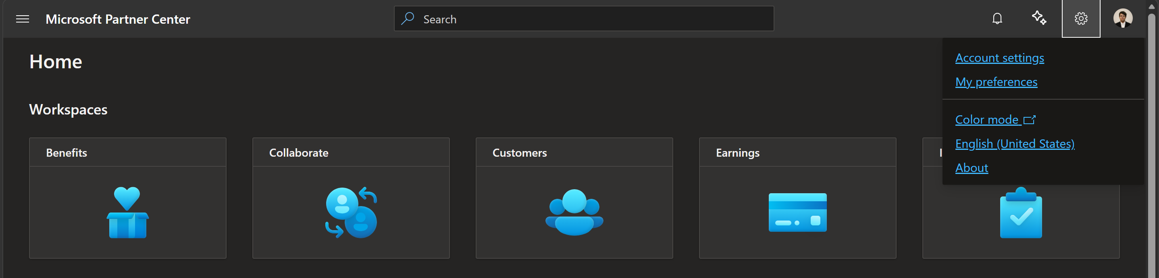
Find your Partner ID
Notes:
https://learn.microsoft.com/en-us/partner-center/enroll/verification-responses

Slide 30
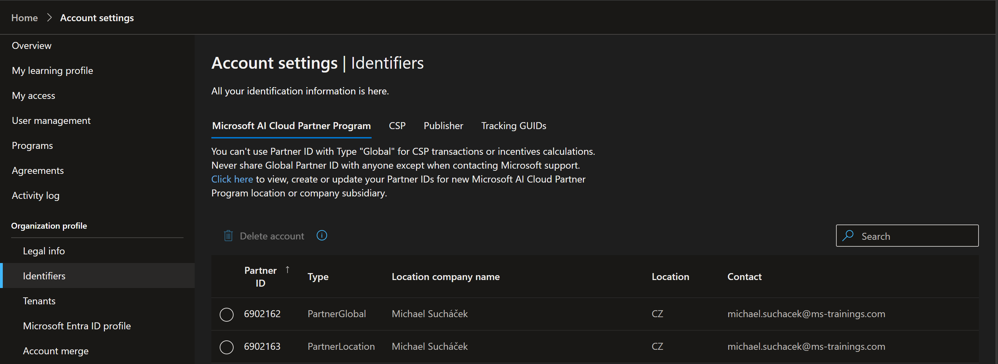
Find your Partner ID
Notes:
https://learn.microsoft.com/en-us/partner-center/enroll/verification-responses

Slide 31
Step 5: Onboard as TSP
Fill out the TSP Onboarding Form
If you are not getting an email confirmation after a month of filling out the form, create a post on the TSP forum
Notes:
https://aka.ms/TSPOnboard

Slide 32
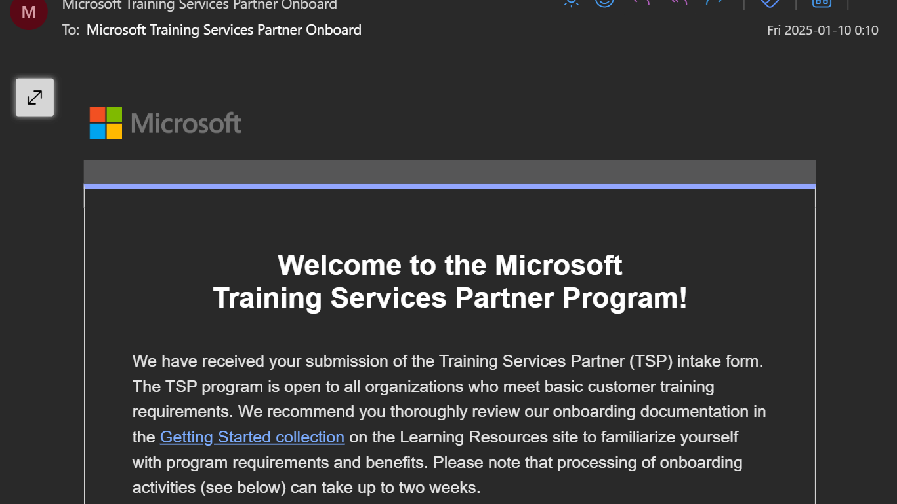

Slide 33
Step 6: Register for Microsoft Learn Achievement Codes
Fill out the registration form
The official steps also guide you to register it under a personal Microsoft account, don‘t do that.
If it is not working after a month of filling out the form, create a post on the TSP forum
Notes:
https://aka.ms/LearnEnrollmentForm

Slide 34
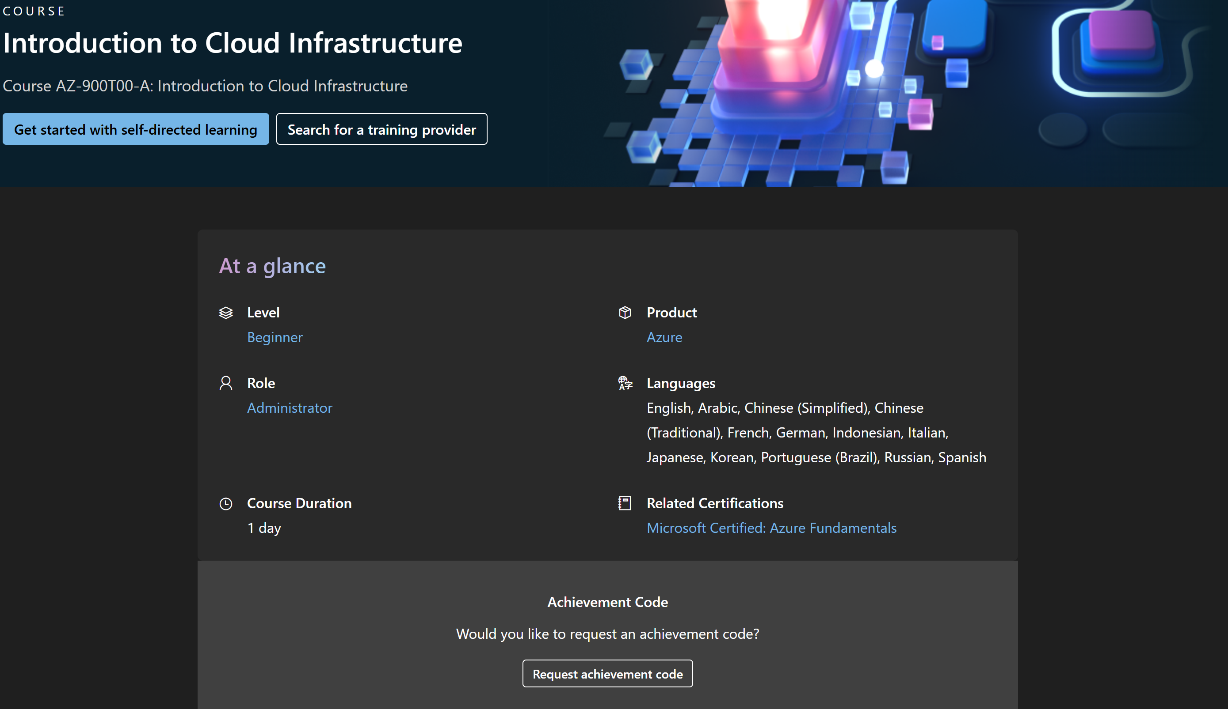

Slide 35
Step 7: Sign-Up for MTM
Fill out the registration form
Add MCTs
Add Courses
Create Classes
Notes:
https://share.hsforms.com/1bUVMNmENStawXrrmyPIAUwbyfib - Registration
https://onlinehelp.explorance.com/mtm/Content/introtopics/headmspartners.html?tocpath=Channels%252C%20Learning%20Partners%20and%20Certified%20Instructors%7CMicrosoft%7CMicrosoft%20Training%20Service%20Partner%7C_____0 - Documentation

Slide 36
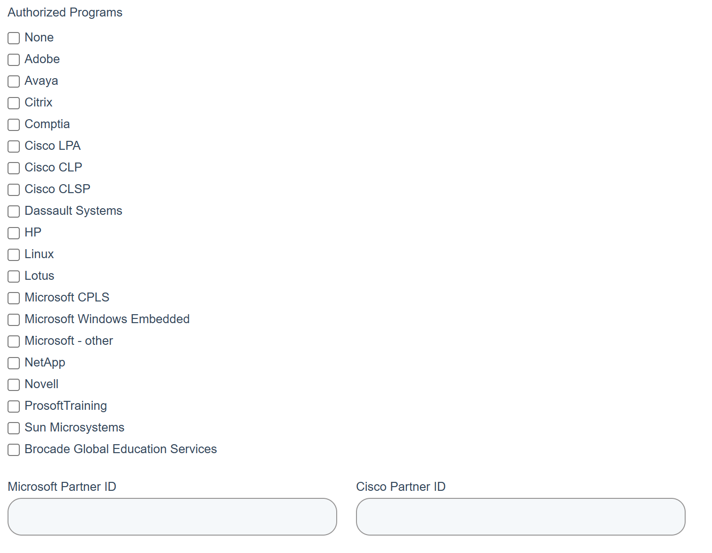

Slide 37
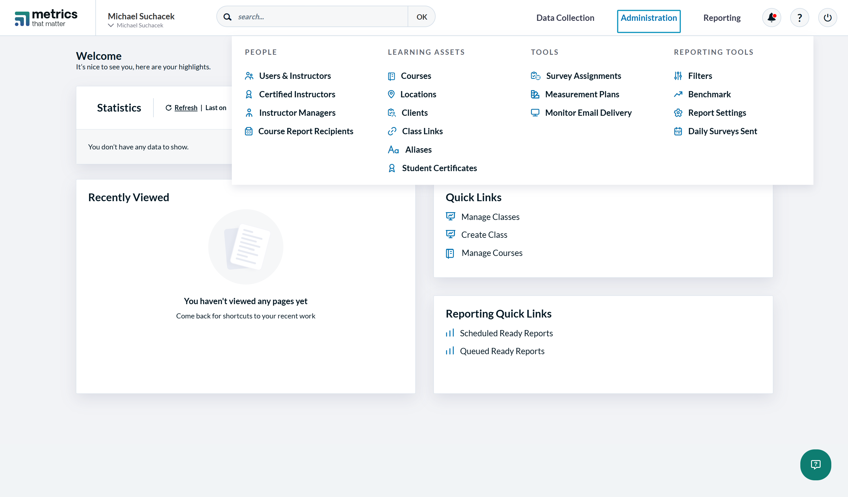

Slide 38
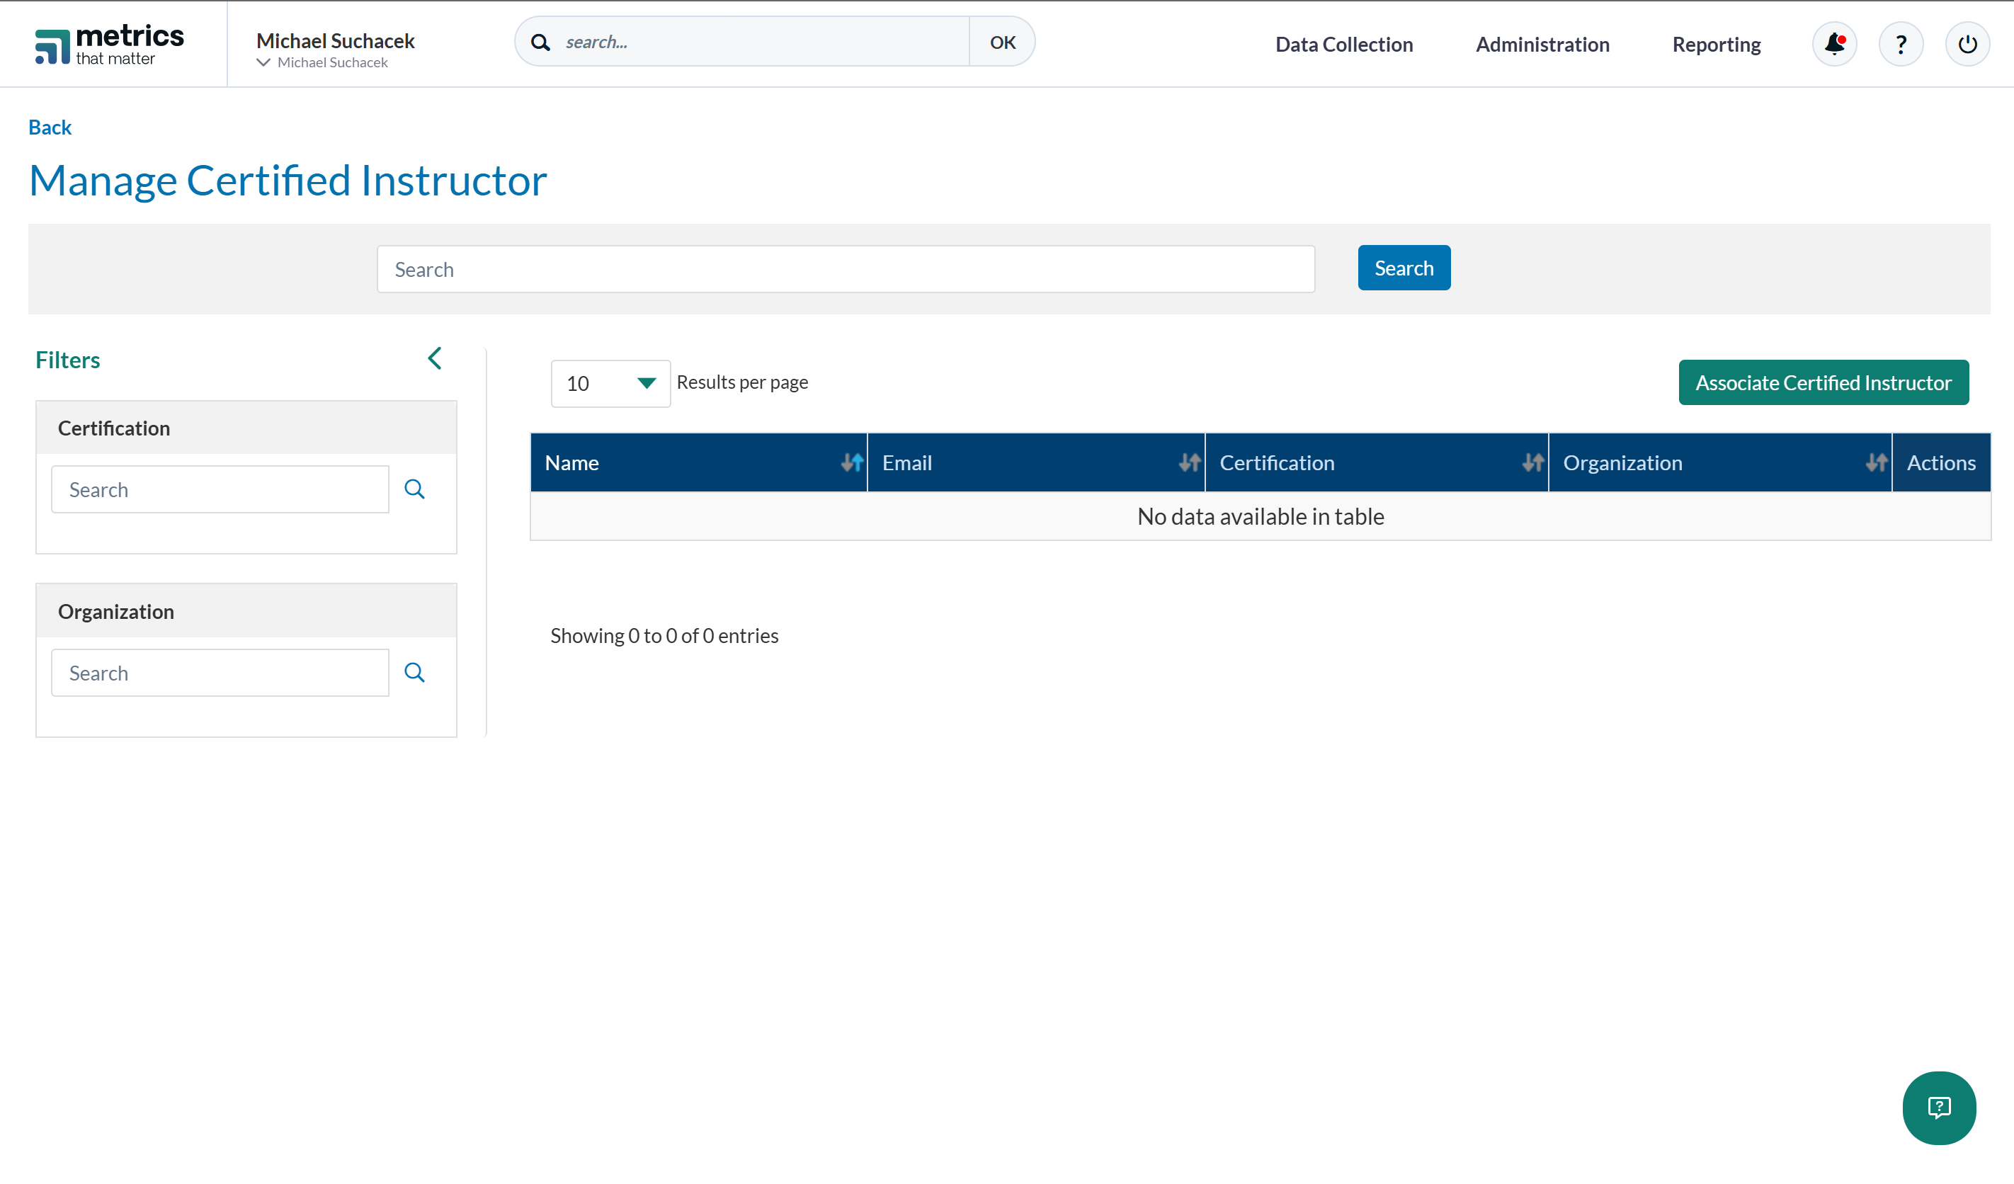

Slide 39
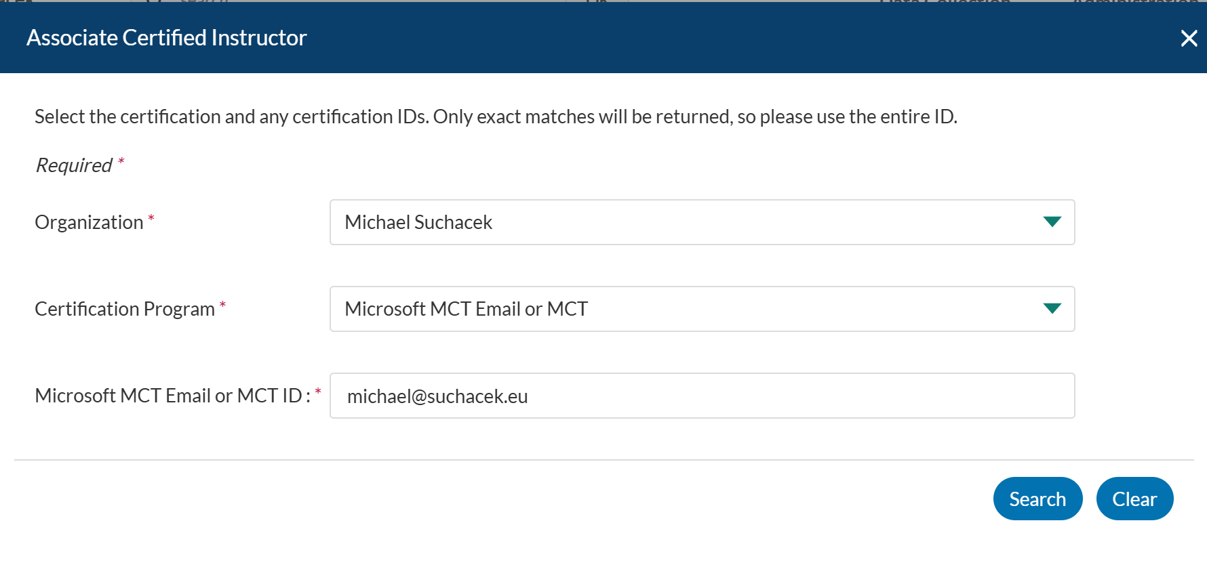

Slide 40
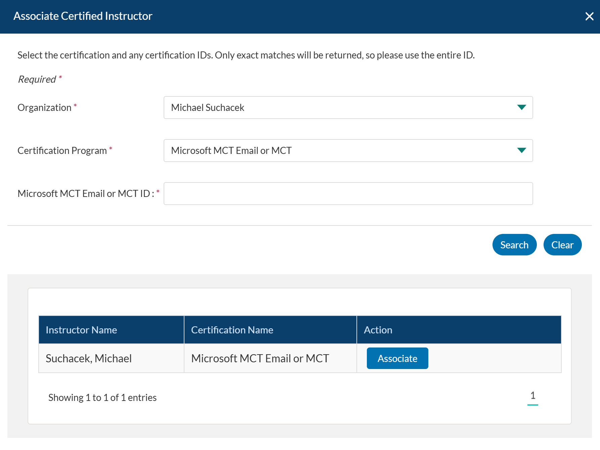

Slide 41


Slide 42
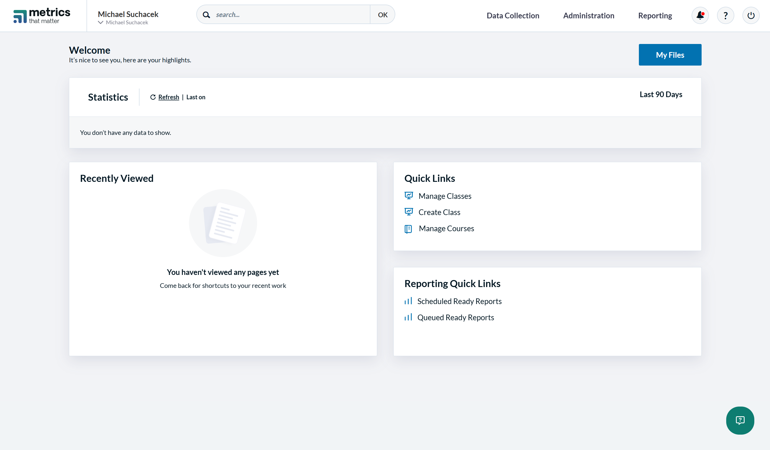

Slide 43
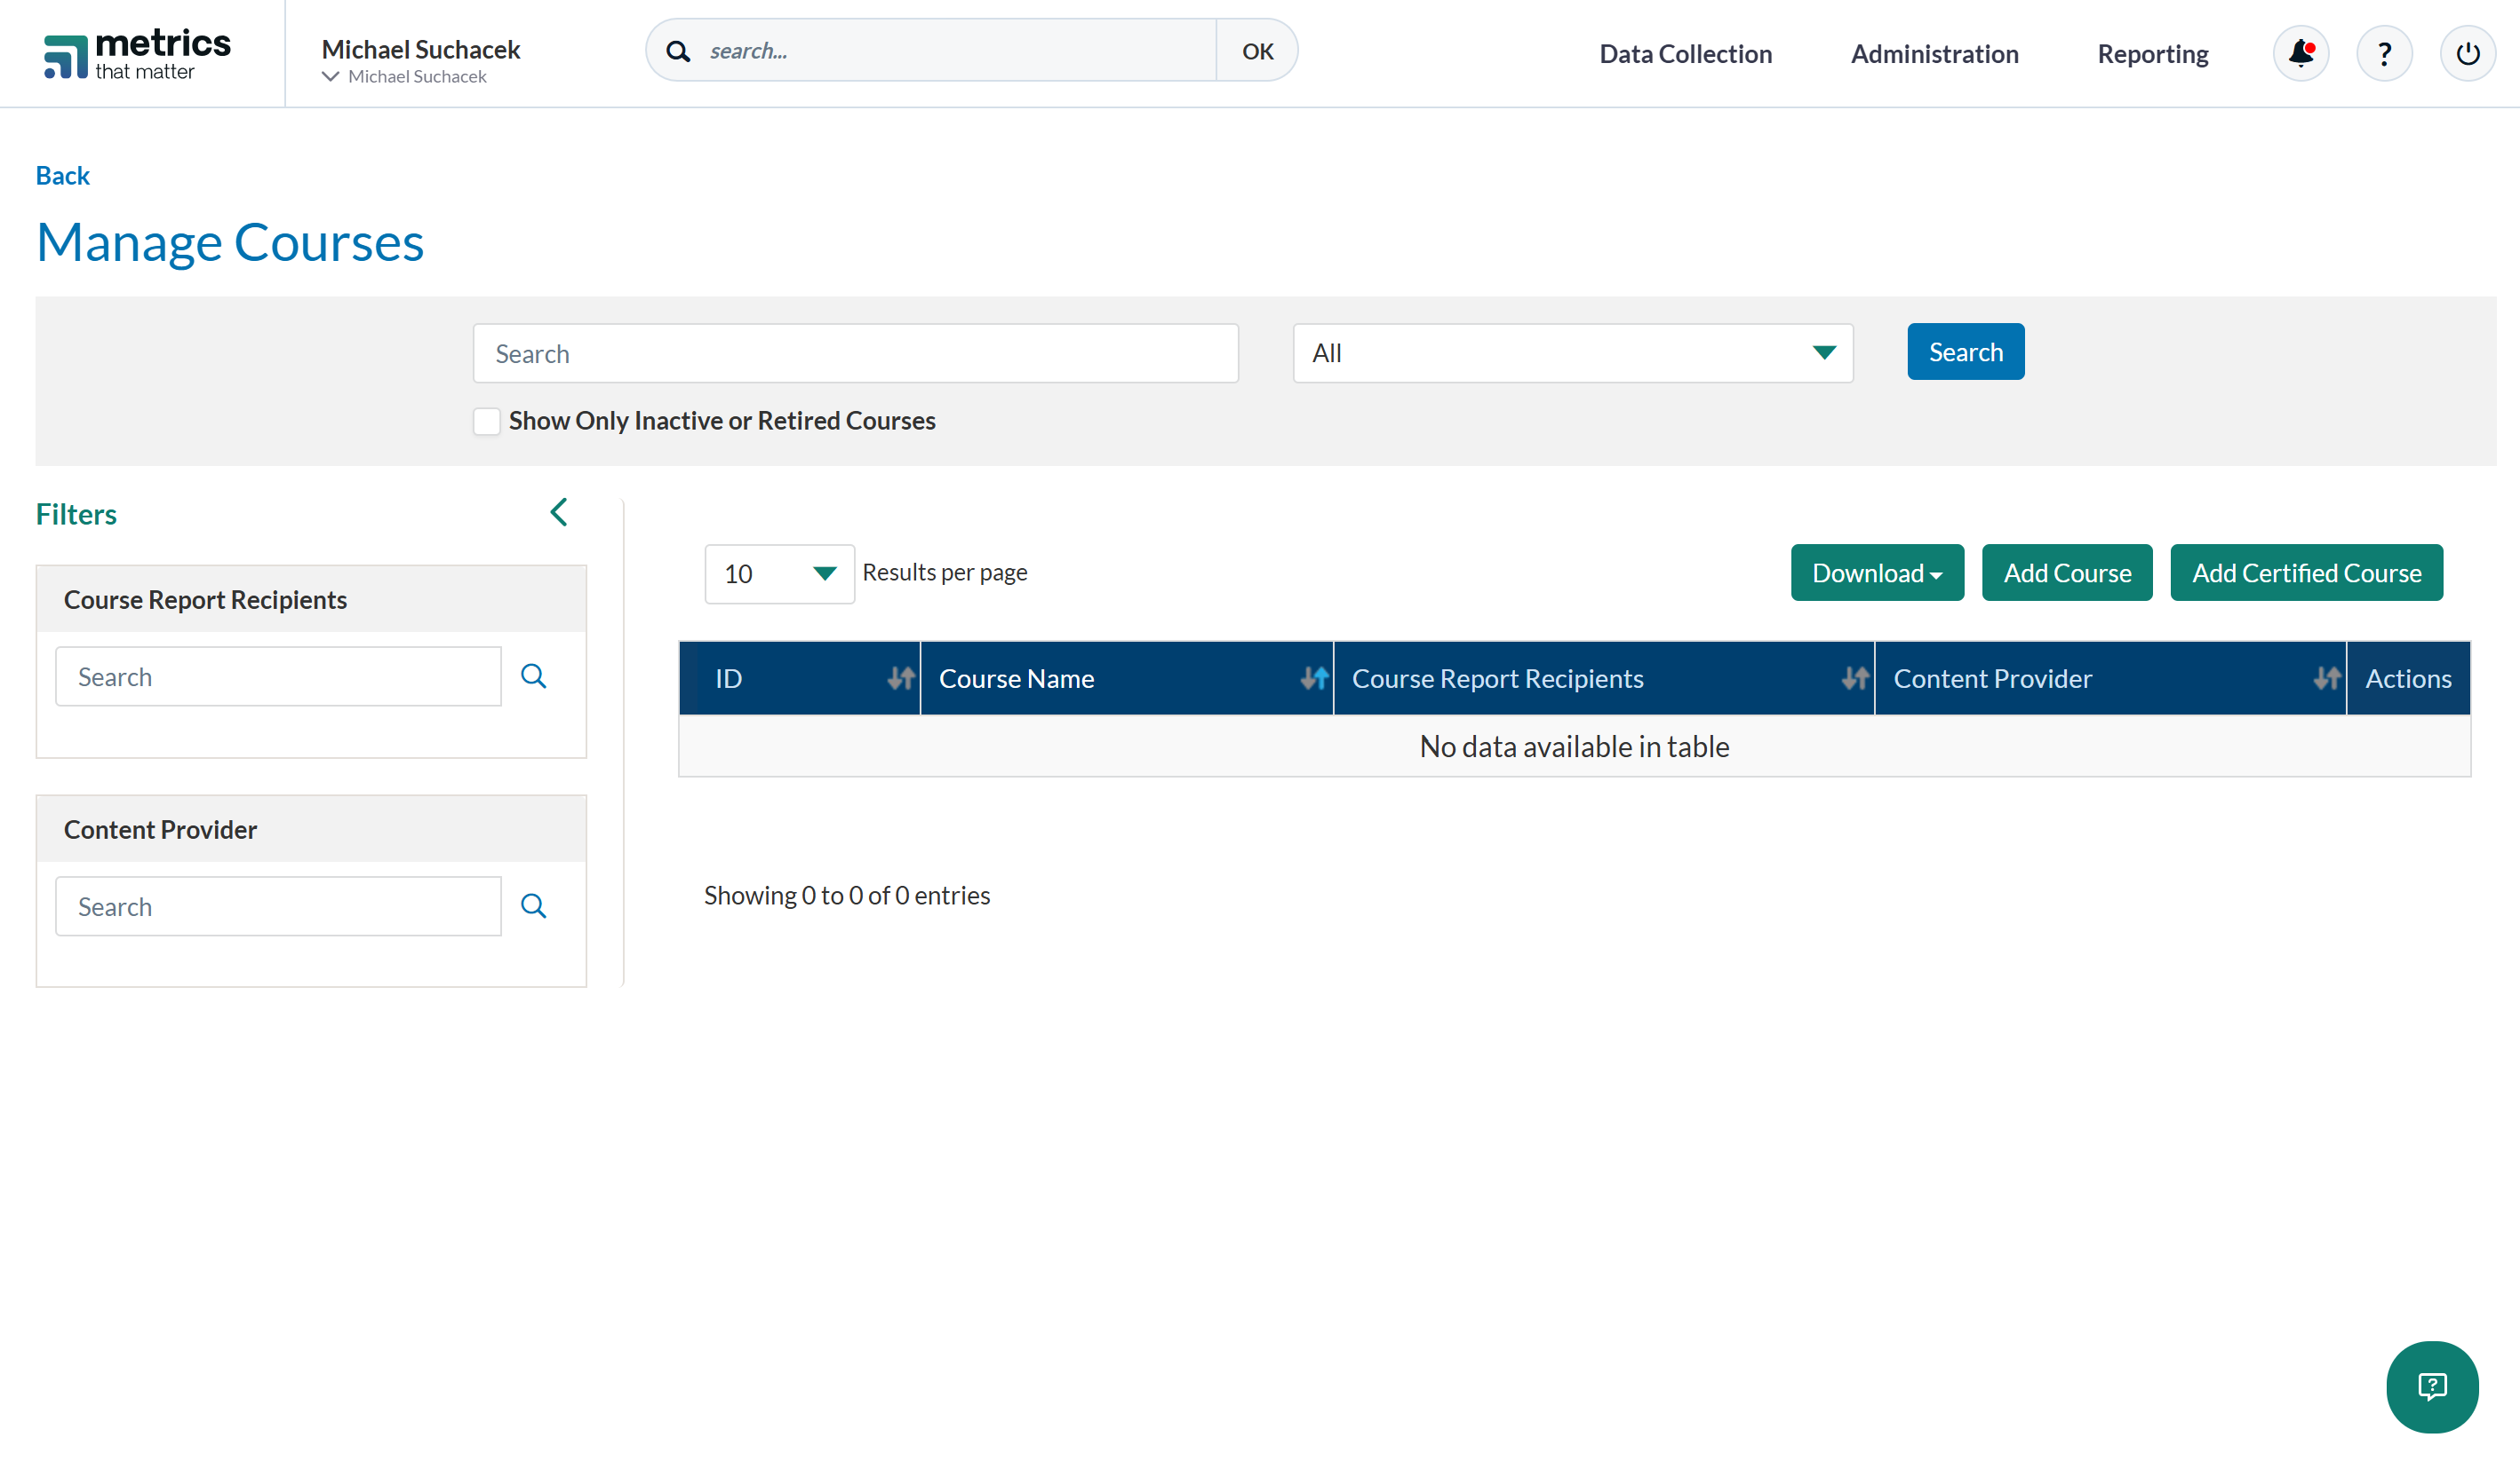

Slide 44
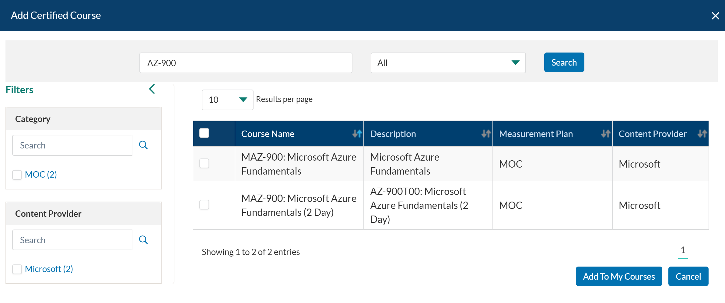

Slide 45
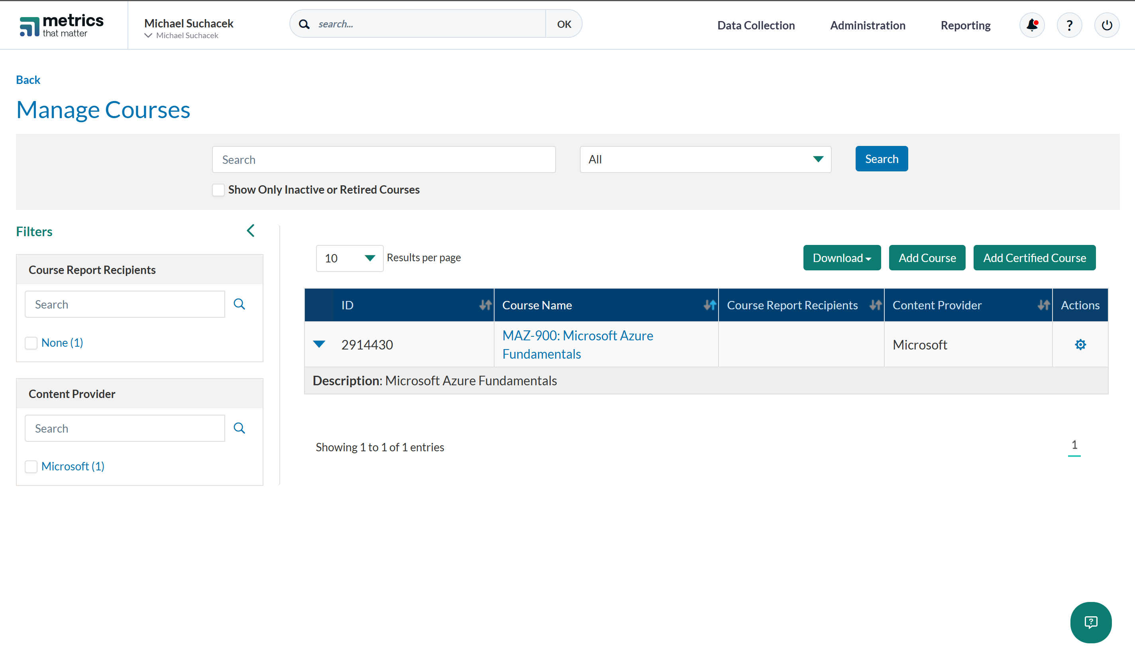

Slide 46
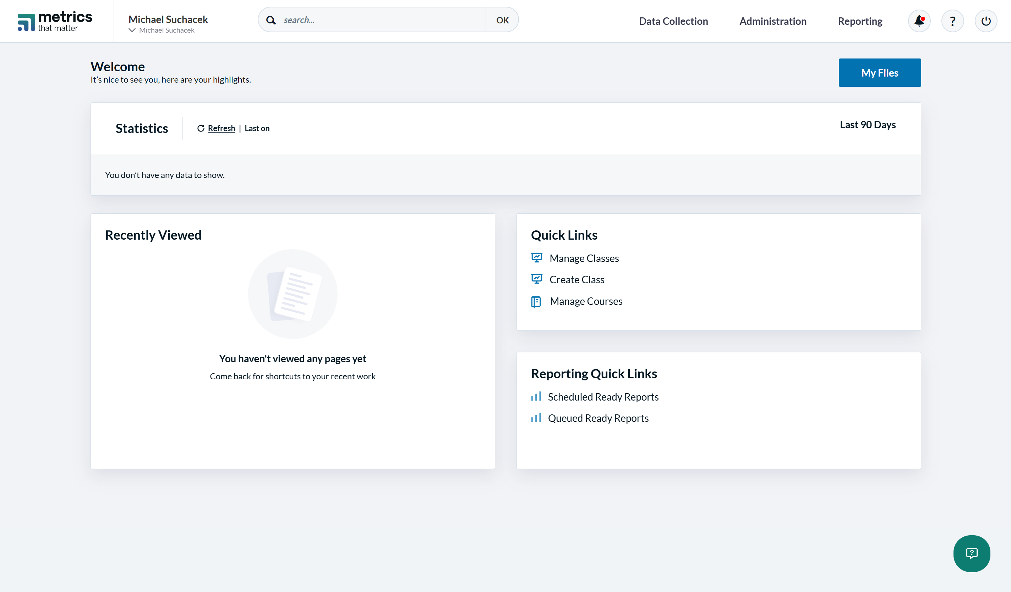

Slide 47
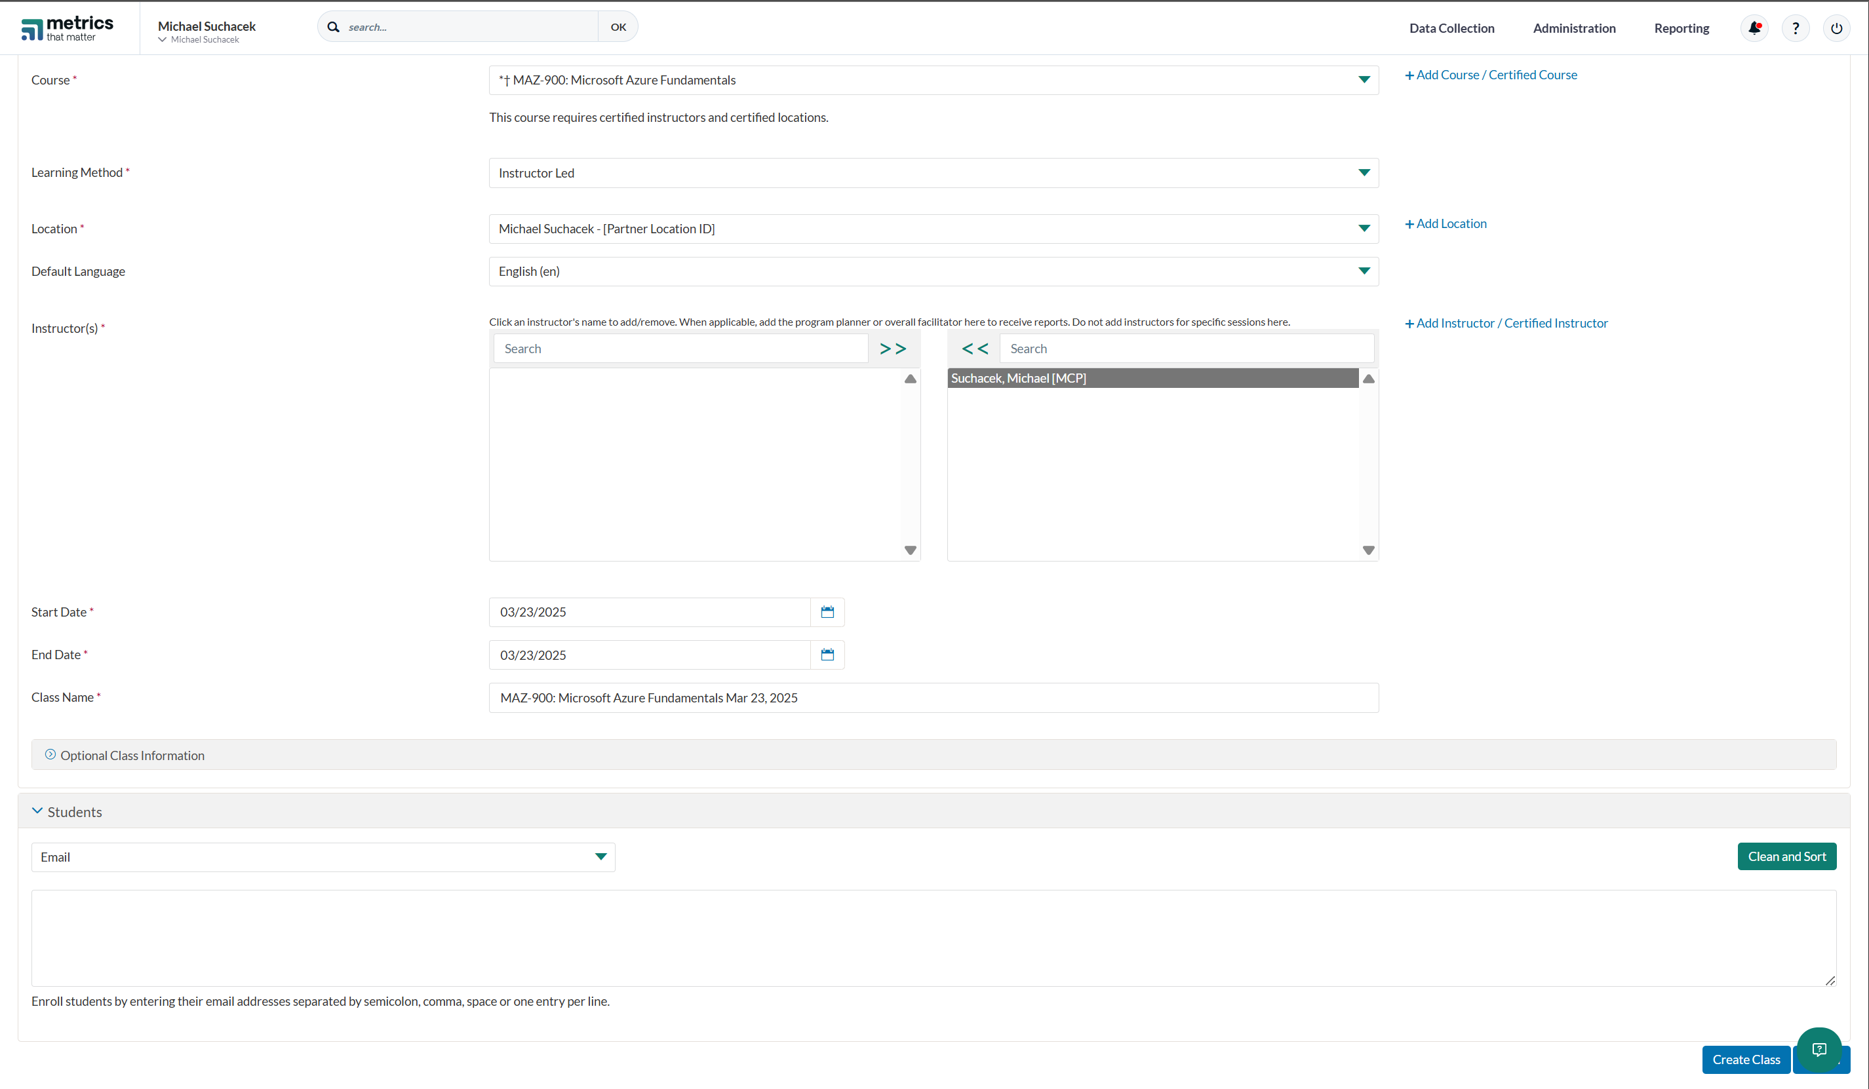

Slide 48
Step 8: Sign up for ALH(s)
GoDeploy
XtremeLabs
Skillable
Each has a different sign up process
MCTs get free access so you can test them out and compare which one you like the most

Slide 49
Step 9: Sign-Up for PearsonVue Partner Store
You can purchase discounted exam vouchers and practice tests here
Notes:
https://msstore.pearsonvue.com/user/signup

Slide 50
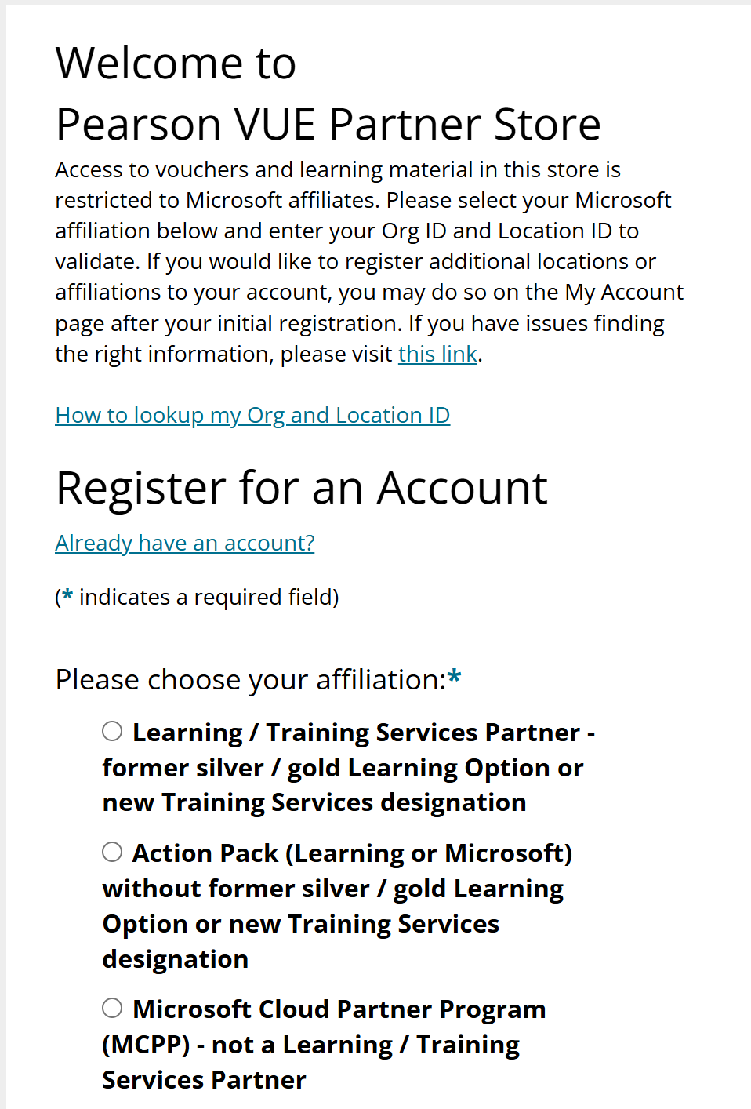

Slide 51
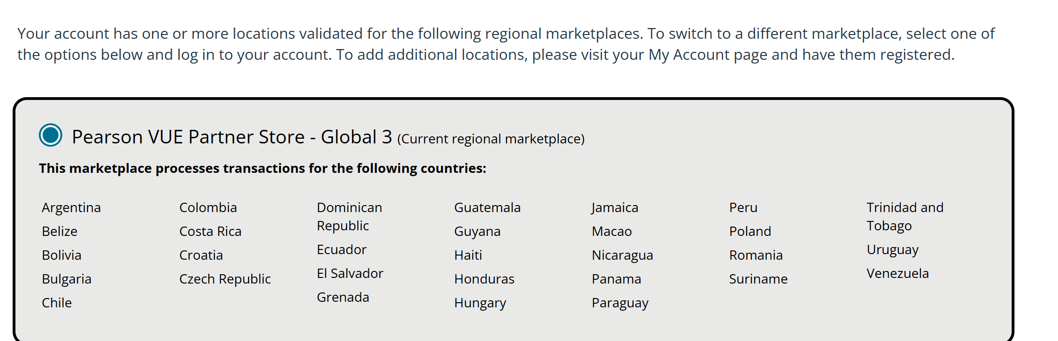

Slide 52
Step 10: Potential Benefits
Microsoft Partner Benefit Packs
Microsoft Learn Commercial Use
Microsoft Demo Experiences (MDX)
TSP Calls

Slide 53
Microsoft Partner Benefit Packs
3 tiers:
Partner Launch Benefits
Partner Success Core
Partner Success Expanded
Extremely discounted Microsoft software
M365 licenses, Security add-ons, Azure Credits
Don‘t have to buy them but they are really good value

Slide 54
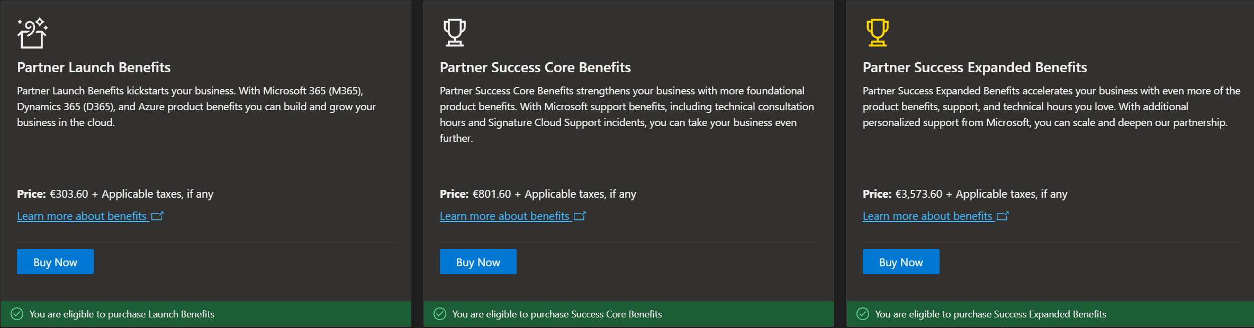

Slide 55
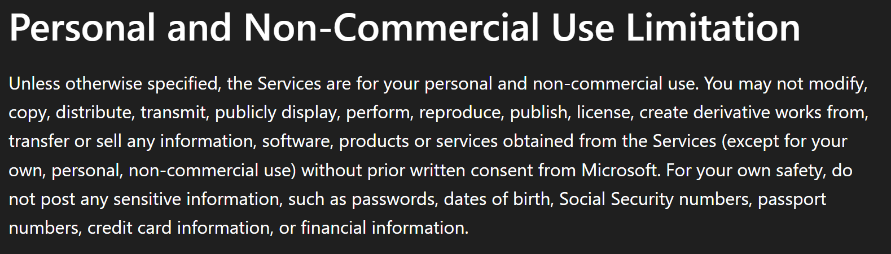
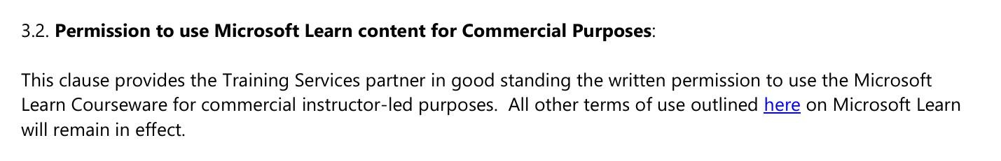
Microsoft Learn Commercial Use
No one except TSPs is allowed to use Microsoft Learn for commercial use
Notes:
https://learn.microsoft.com/en-us/legal/termsofuse#personal-and-non-commercial-use-limitation
https://assetsprod.microsoft.com/mpn/en-us/training-services-partner-guidelines.pdf

Slide 56
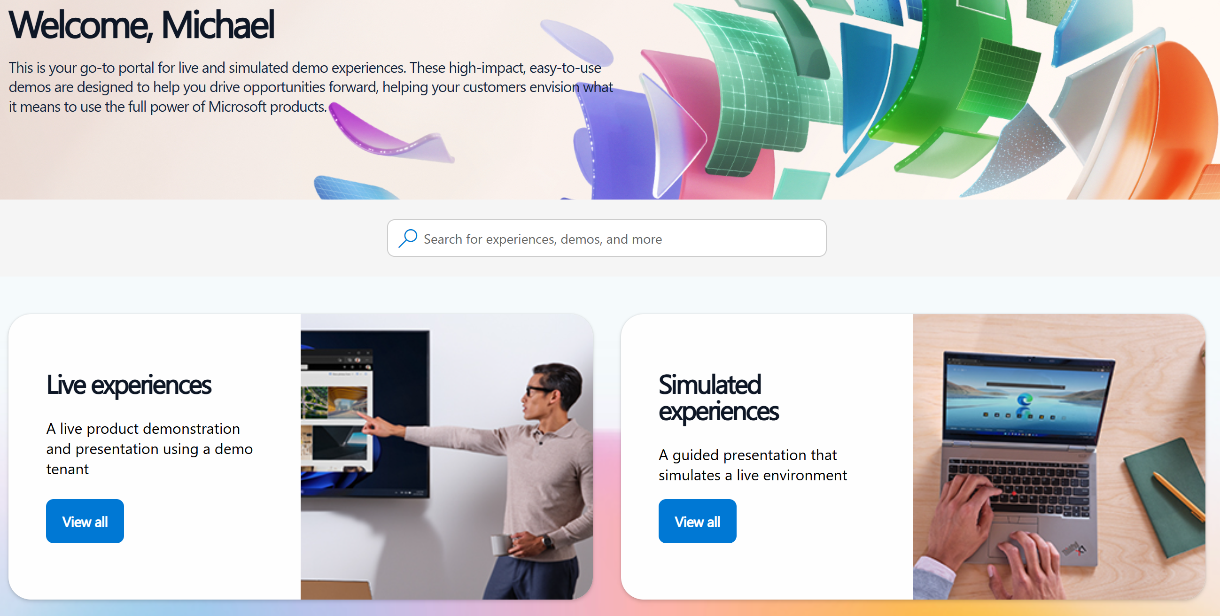
Microsoft Demo Experiences
Access to M365 Tenants and Demos

Slide 57
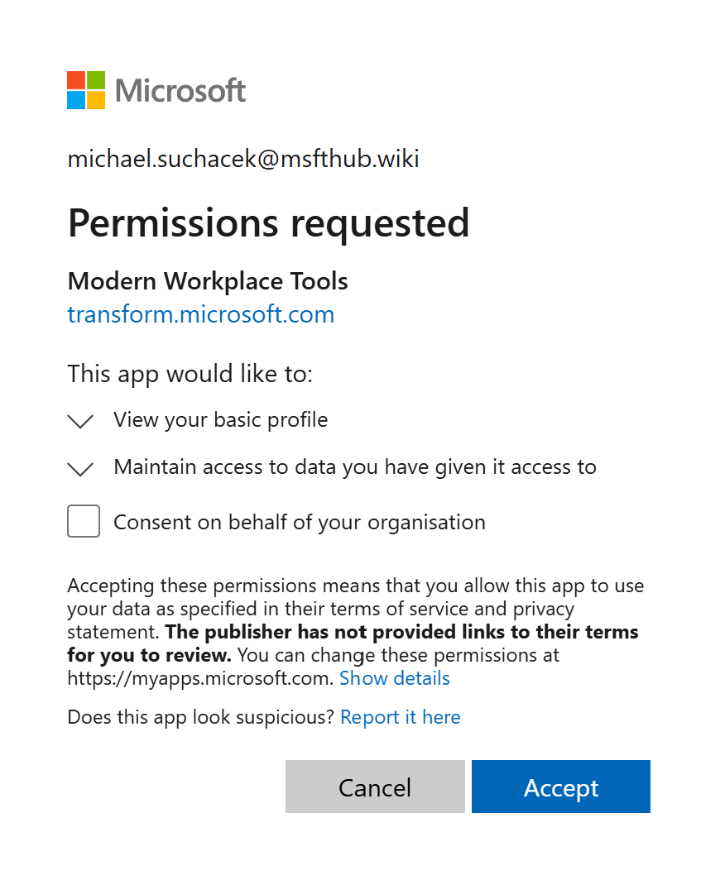
How to access MDX
Go to https://cdx.transform.microsoft.com
Authorize the application (Admin Consent)
Continued on next slide
Notes:
https://cdx.transform.microsoft.com

Slide 58
How to access MDX - Continued
One of these will throw an error, that is normal:
In Azure Cloud Shell (Not normal PowerShell):
install-module AzureAD
connect-azuread -tenantid [Your tenant ID]
New-AzureADServicePrincipal -AppId fa3d9a0c-3fb0-42cc-9193-47c7ecd2edbd
New-AzureADServicePrincipal -AppId 4990cffe-04e8-4e8b-808a-1175604b879f
After that open this URL and again provide Consent
https://login.microsoftonline.com/common/oauth2/authorize?response_type=id_token&prompt=consent&client_id=fe6aa35b-7da8-44fd-a44e-e2d4bafbdab5&redirect_uri=https%3A%2F%2Fcdx.transform.microsoft.com&state=a9985c9c-6c9a-4b65-a444-1e3aa90d27a4&client-request-id=6b3f4e71-ed02-406c-96f2-0a7e3c16ea98&x-client-SKU=Js&x-client-Ver=1.0.17&nonce=09492f5a-fb1a-412c-b24a-ba1704900924

Slide 59
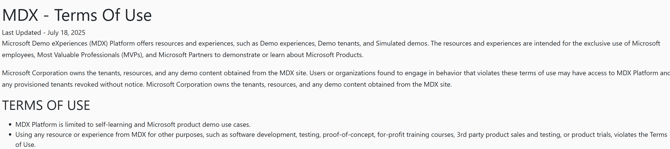

Slide 60
Important Resources
TSP Techcommunity – support forum and contains all important information
TSP Learning Resources – Explanations, Guides, Guidelines for the TSP program, History of the TSP calls
Microsoft Training Services Partner Overview
Get started guide: Microsoft Training Services partners
Training Services Partner Guidelines
Pearson Partner Store Registration Instructions
Notes:
https://techcommunity.microsoft.com/category/mcpp/discussions/learningpartnertraining
https://partner.microsoft.com/en-us/marketing/learning-resources#/
https://assetsprod.microsoft.com/mpn/en-us/microsoft-training-services-partner-overview.pdf
https://assetsprod.microsoft.com/mpn/en-us/get-started-guide-microsoft-training-services-partners.pdf
https://assetsprod.microsoft.com/mpn/en-us/training-services-partner-guidelines.pdf
https://assetsprod.microsoft.com/mpn/en-us/pearson-partner-store-registration-instructions.pdf

Slide 61
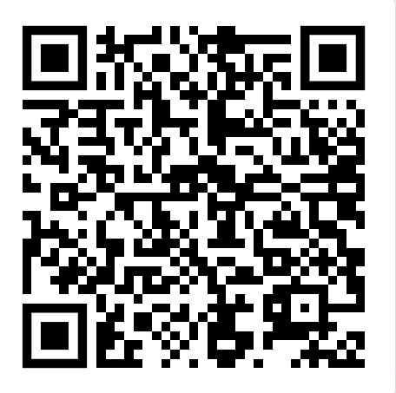
Get the presentation

Slide 62



